Slide 1
Unified Modeling Language (UML)
Basic Concepts

Slide 2
What is the UML?
UML stands for Unified Modeling Language
The UML combines the best of the best from:
Data Modeling concepts (Entity Relationship Diagrams)
Business Modeling (Work Flow)
Object Modeling
Component Modeling
The UML is a standard language for specifying, visualizing, documenting and constructing the artifacts of a software-intensive system
It can be used with all processes, throughout the development life cycle, and across different implementation technologies.

Slide 3
UML Usage:
The UML may be used to:
Represent the Elements of a system or a domain and their Relationships in a Static Structure using class and object diagrams.
Model the Behavior of objects with state transition diagrams.
Reveal the Physical Implementation Architecture with component & deployment diagrams.
Display the Boundary of a System & its major Functions using use cases and actors.

Slide 4
UML: Basic Types of Concepts
Modeling elements
Relationships
Diagrams

Slide 5
Basic Modeling Elements
Structural elements
type, class, instance, collaboration, use case, component, node
Behavioral elements
interaction, state machine
Grouping elements
package, subsystem

Slide 6
Classes and Instances
Specifications for one or more distinct objects with a common form (structure and behavior)
instance
class
phone1:Telephone
busy = true
offHook()
onHook ()
ring()
Telephone
phone2:Telephone
busy : boolean
busy = false
offHook()
onHook ()
ring()
offHook()
onHook ()
ring()

Slide 7
Attributes
The data/static structure aspect of a class is represented by its attributes
Attributes may be found by examining class definitions, the problem requirements, and by applying domain knowledge
Course Offering
Each course offering
has a number, location
and time
number
location
time
Notes:
27

Slide 8
Operations
The behavior of a class is represented by its operations
Operations may be found by examining interaction diagrams
registration
registration
form
manager
RegistrationManager
addCourse(joe, math 01)
addCourse(Student,Course)
Notes:
26

Slide 9
Relationships
Relationships provide a pathway for communication between objects.
Sequence and/or collaboration diagrams are examined to determine what links between objects need to exist to accomplish the behavior -- if two objects need to “talk” there must be a link between them.
Notes:
29

Slide 10
Basic Relationship Types
Association
Dependency
Aggregation
Generalization
Realization

Slide 11
Relationships:
An association is a bi-directional connection between classes
An association is shown as a line connecting the related classes
An aggregation is a stronger form of relationship where the relationship is between a whole and its parts
An aggregation is shown as a line connecting the related classes with a diamond next to the class representing the whole
A dependency relationship is a weaker form of relationship showing a relationship between a client and a supplier where the client does not have semantic knowledge of the supplier.
A dependency is shown as a dashed line pointing from the client to the supplier
Notes:
30

Slide 12
Generalization (Inheritance)
A generalization is a relationship between a more general and a more specific element
Inheritance is the main property of generalization-specialization relationships defined between a superclass and its subclasses
Common attributes, operations, and/or relationships are shown at the highest applicable level in the hierarchy
Realization is a relationship defined between a type and its implementation classes.
Notes:
35

Slide 13
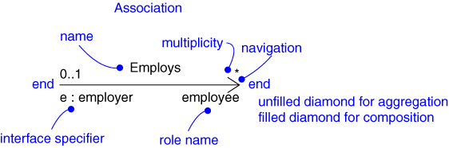
Relationships: Notation
Association
Dependency
Aggregation
Generalization
Realization
Client
name
Supplier
Part
Aggregate
Superclass
Subclass
type
Implementation
class

Slide 14
Models and Diagrams
A model is a complete
description of a system
from a particular
Perspective.
Class
Diagrams
Use Case
Diagrams
Object
Diagrams
Sequence
Diagrams
Collaboration
Diagrams
Component
Diagrams
Models
Statechart
Diagrams
Activity
Diagrams
Deployment
Diagrams

Slide 15
Why Build Models?
To understand the problem better
To communicate with stakeholders
To find errors
To plan out the design
To generate code

Slide 16
UML Model Views
Requirements (use case diagrams)
Static structure (class diagrams)kinds of objects and their relationships
Dynamic behavior (state machines)
possible life histories of an object
Interactive behavior (activity, sequence, and collaboration diagrams)
flow of control among objects to achieve system-level behavior
Physical implementation structures (component and deployment diagrams)
software modules and deployment on physical nodes

Slide 17
Diagrams
In the UML, there are nine standard diagrams
Static views: use case, class, object, component, deployment
Dynamic views: sequence, collaboration, statechart, activity

Slide 18
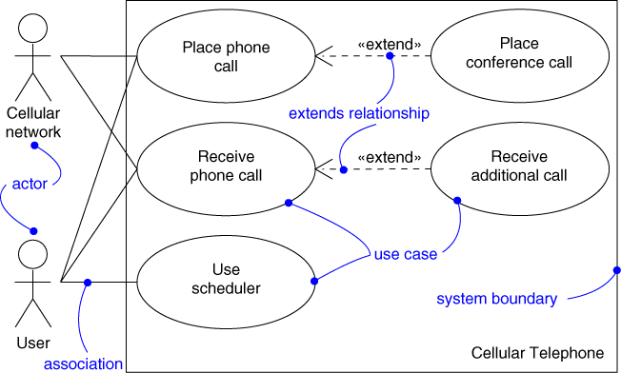
Use Case Diagram
Captures system functionality as seen by users

Slide 19
Use Case Diagram
Captures system functionality as seen by users
Built in early stages of development
Purpose
Specify the context of a system
Capture the requirements of a system
Validate a system’s architecture
Drive implementation and generate test cases
Developed by analysts and domain experts

Slide 20
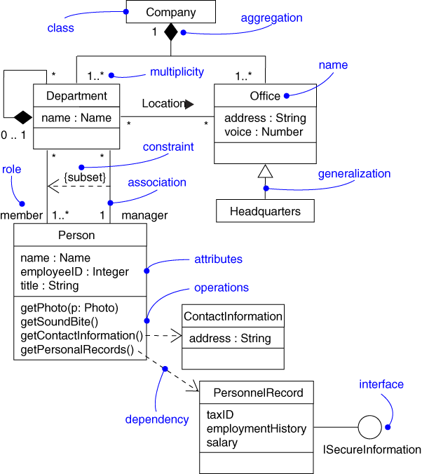
Class Diagram
Captures the vocabulary of a system

Slide 21
Class Diagram
Captures the vocabulary of a system
Built and refined throughout development
Purpose
Name and model concepts in the system
Specify collaborations
Specify logical database schemas
Developed by analysts, designers, and implementers

Slide 22
Class Diagram: Example
Shows the entities in a system and their general relationships
client
creditor
Financial Institution
Person
0..*
0..*
owner
0..*
generalization
association
Bank
Trust Company
residence
0..*
House

Slide 23
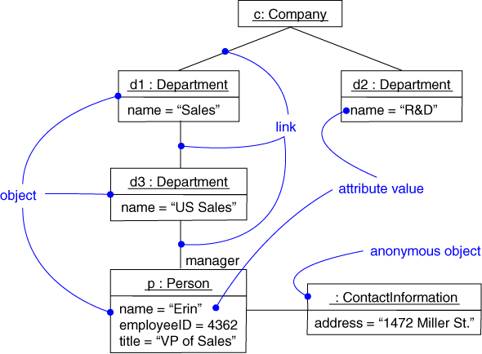
Object Diagram
Captures instances and links

Slide 24
Object Diagram
Shows instances and links
Built during analysis and design
Purpose
Illustrate data/object structures
Specify snapshots
Developed by analysts, designers, and implementers

Slide 25
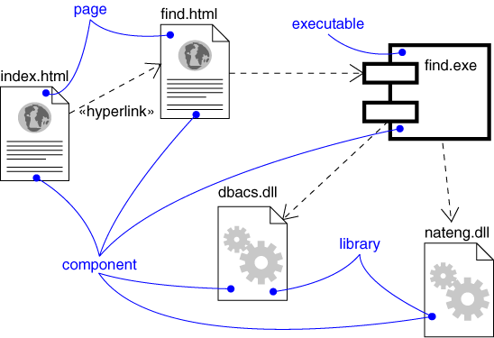
Component Diagram
Captures the physical structure of the implementation

Slide 26
Component Diagram
Captures the physical structure of the implementation
Purpose
Organize source code
Construct an executable release
Specify relationship between the components of system
Developed by architects and programmers

Slide 27
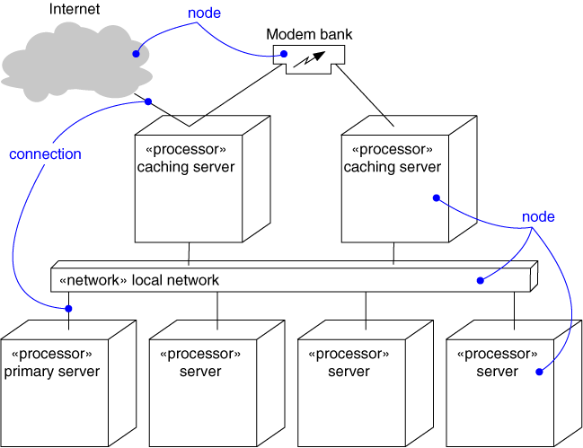
Deployment Diagram
Captures the topology of a system’s hardware

Slide 28
Deployment Diagram
Captures the topology of a system’s hardware
Purpose
Specify the distribution of components
Identify performance bottlenecks
Developed by architects, networking engineers, and system engineers

Slide 29
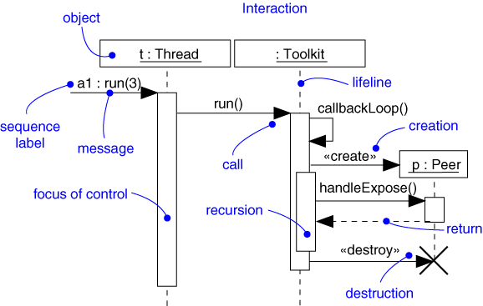
Sequence Diagram
Captures dynamic behavior (time-oriented)

Slide 30
Sequence Diagram
Captures dynamic behavior (time-oriented)
Purpose
Model flow of control
Illustrate typical scenarios

Slide 31
Sequence Diagram: Example
Assertions of legal interactions between objects (e.g., operator-assisted call)
sequence diagram
Caller
Operator
Callee
call
ack
number
call
ack
transfer
talk
time

Slide 32
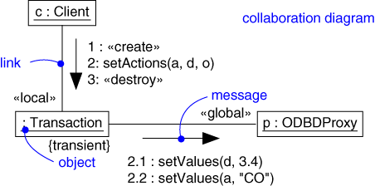
Collaboration Diagram
Captures dynamic behavior (message-oriented)

Slide 33
Collaboration Diagram
Captures dynamic behavior (message-oriented)
Purpose
Model flow of control
Illustrate coordination of object structure and control

Slide 34
Collaboration Diagram: Example
A collaboration diagram displays object interactions organized around objects and their links to one another
course form :
CourseForm
1: set course info
2: process
: Registrar
3: add course
aCourse :
theManager :
CurriculumManager
Course
4: new course
Notes:
22

Slide 35
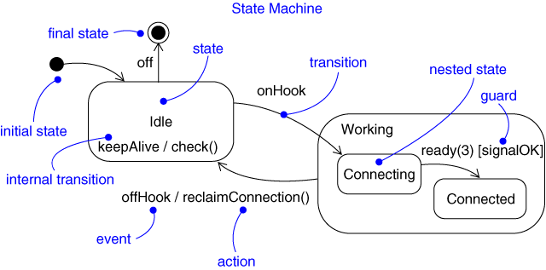
Statechart Diagram
Captures dynamic behavior (event-oriented)

Slide 36
Statechart Diagram
Captures dynamic behavior (event-oriented)
Purpose
Model object lifecycle
Model reactive objects (user interfaces, devices, etc.)

Slide 37
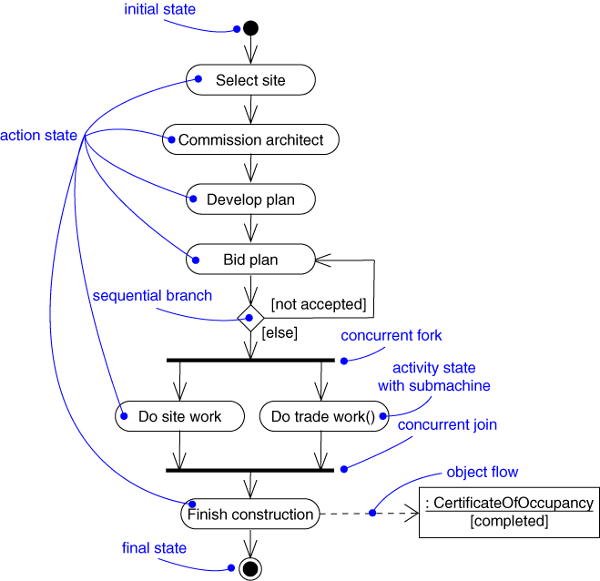
Activity Diagram
Captures dynamic behavior (activity-oriented)

